Slide 1
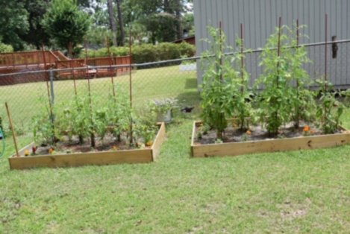
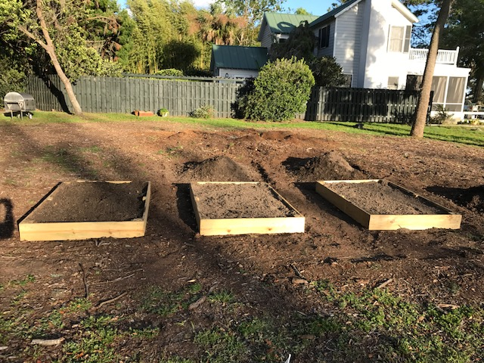
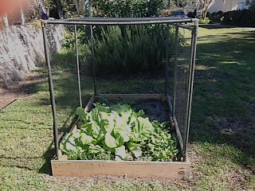
SIMPLY GREEN RAISED GARDEN BOX

Slide 2
WHAT IS A RAISED GARDEN BOX?
The Raised Garden Box is a garden planted on an elevated surface. The box comes with it’s own soil and it is installed on your property as directed by you.
It is constructed in a smaller space and designed to require less time and maintenance, necessary for the traditional vegetable gardens.
You provide your own stems, seeds and watch it grown.
Your vegetables and herbs harvested from from your garden to your table.”
This Garden Box is designed without a protective netting.
This Garden Box is designed with a net to keep animals out of your garden.
Raised Garden Box Without Netting
Two Raised Garden Boxes With Netting

Slide 3
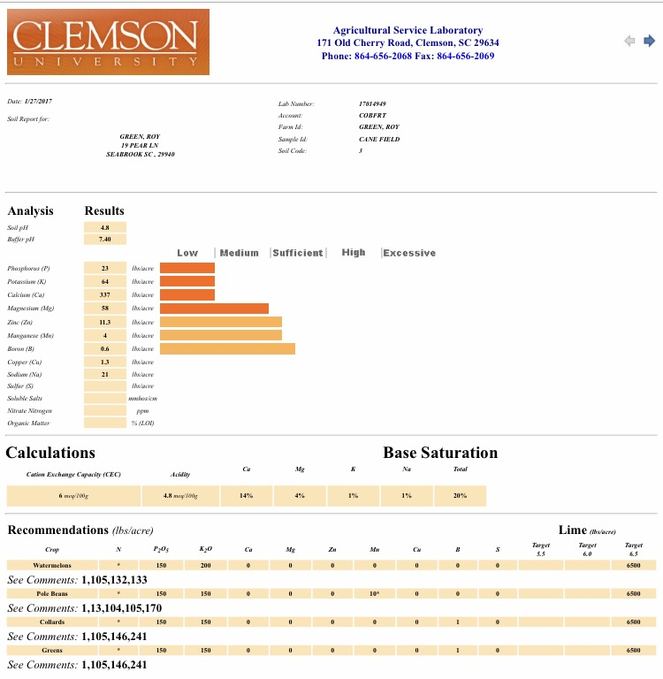
Advantages
of
The Raised Garden Box
Soil analysis results are available
Gardening is a family tradition that has been passed down from generation to generation
During installation consultation is available

Slide 4
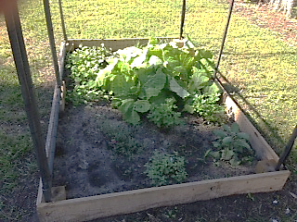
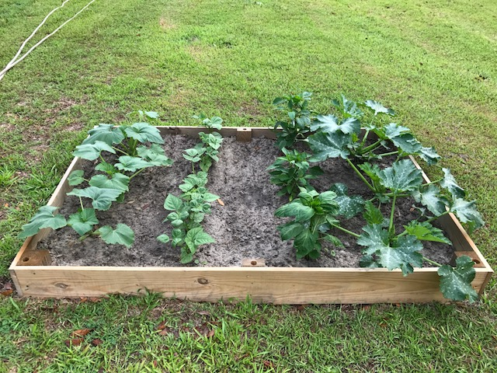
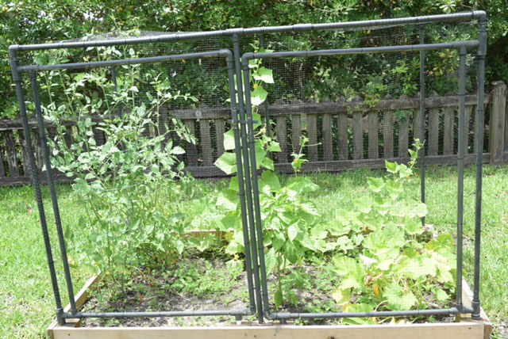
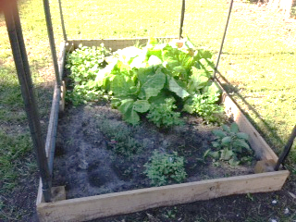
BENEFITS ASSOICATED WITH GROWING YOUR ON GARDEN
Knowing what chemicals if any are added to your foods
Self-grown fruits and vegetables are rich in nutrients, phytochemicals, anti-oxidants, vitamins and folate
Save money on grocery
Increase physical activity
Healthier meals

Slide 5
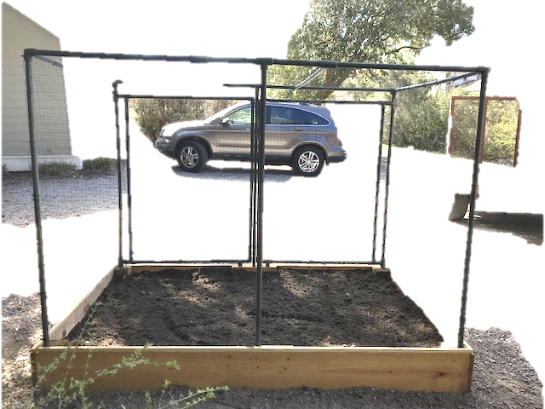
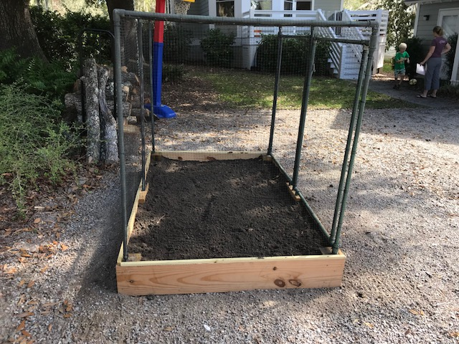
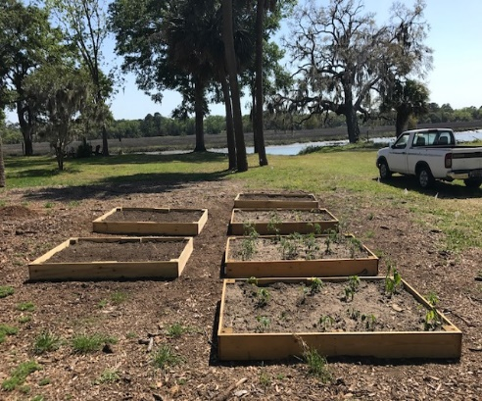
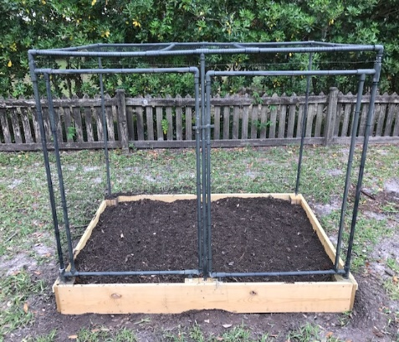
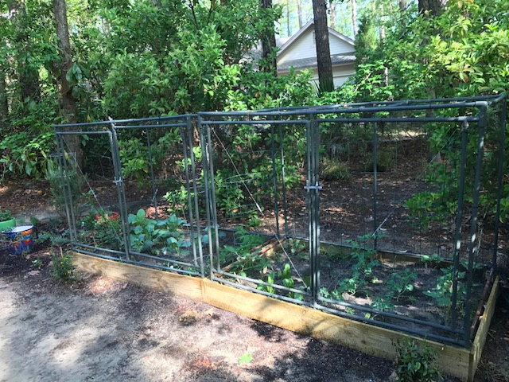
Let the process begin
Decide if you want a Garden Box with or without netting.
Decide where you want the box to be installed. (Lighting from the sun should be a key factor)
Decide how many Garden Boxes you want installed.
Schedule an appointment that will work for you and the owner.
Contact Owner: Business Number (843) 781-6268
Email: simplygreengardenbox@gmail.com
Website: SimplyGreenRaisedGardenBox.com
Select the configuration

Slide 6
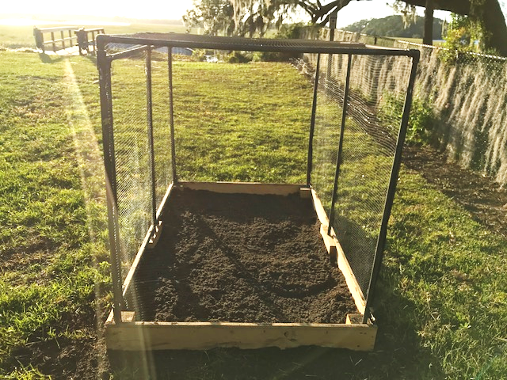
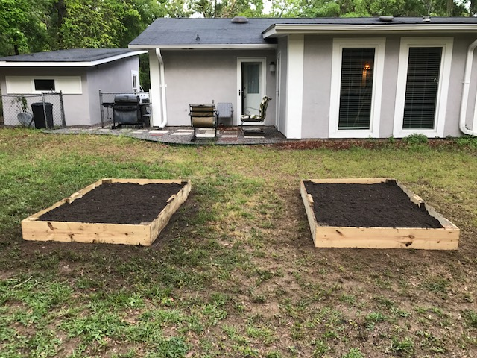
You are now ready to plant your stems or seeds
and watch your garden grow.
After your garden box has been installed, you are now ready to plant your stems or seeds.
It is your responsibility to provide maintenance to your garden. Monitor the amount of sun your garden is receiving. You may need to make necessary adjustments if your garden is receiving excessive sunlight.

Slide 7
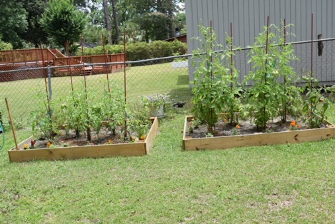
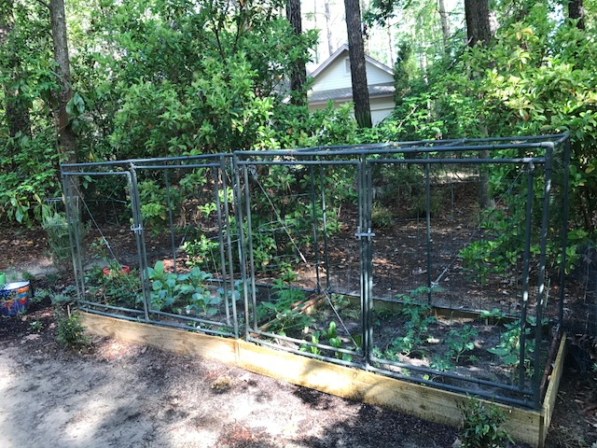
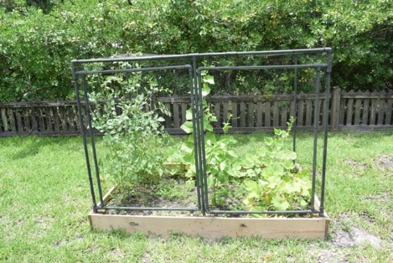
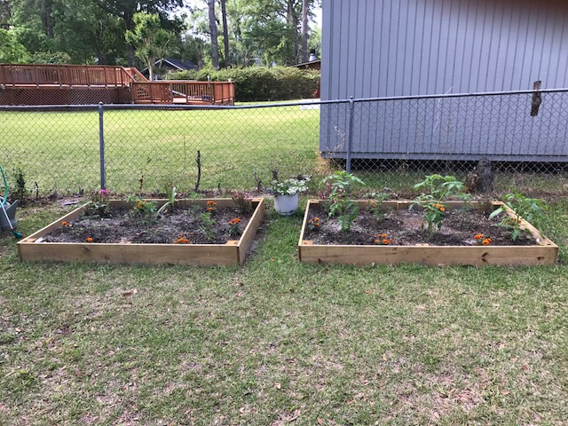
RESULTS OF EXSISTING GARDEN BOXES

